Slide 1
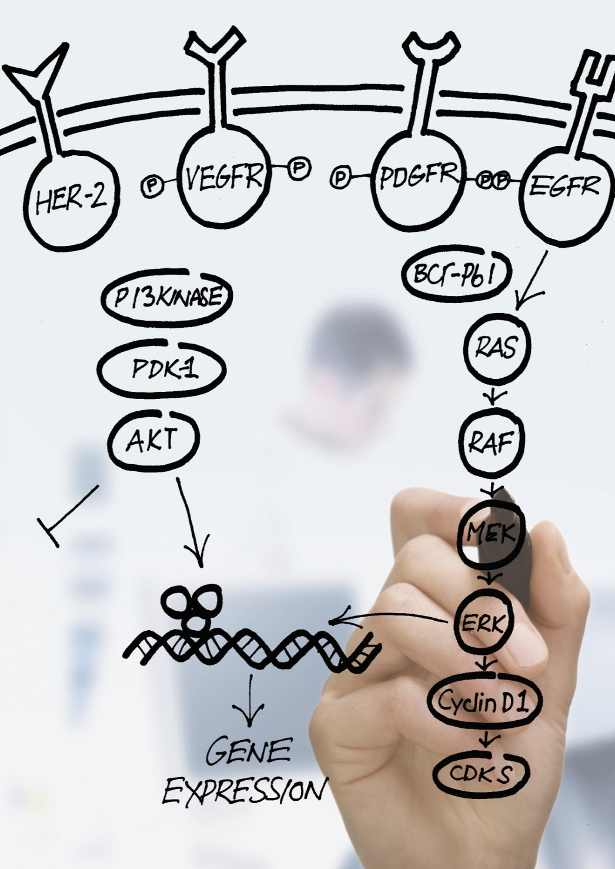
BRCA1/2 Test
QIAGEN (Suzhou)
Translational Medicine Co., Ltd
Bringing Biomarkers & Companion Diagnostics
to Precision Medicine
1

Slide 2
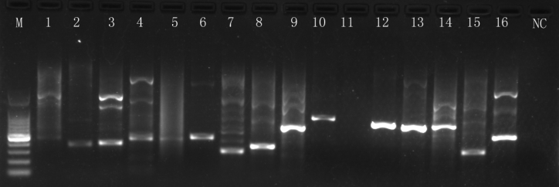
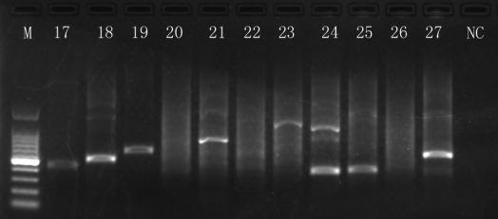
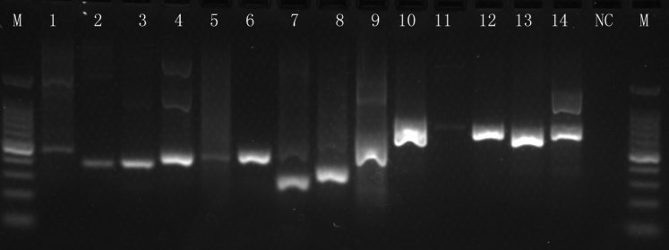
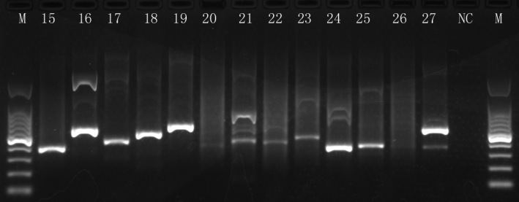
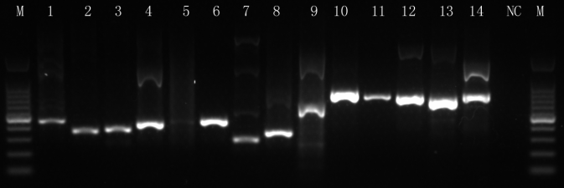
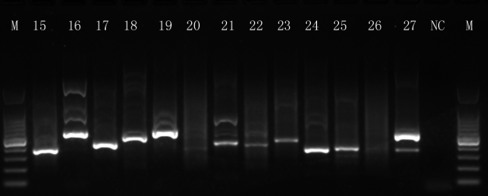
BRCA1 and BRCA2 and Mutations
BRCA1 PCR RESULT
Annealing：55°C
Annealing：58°C
Annealing：60°C

Slide 3
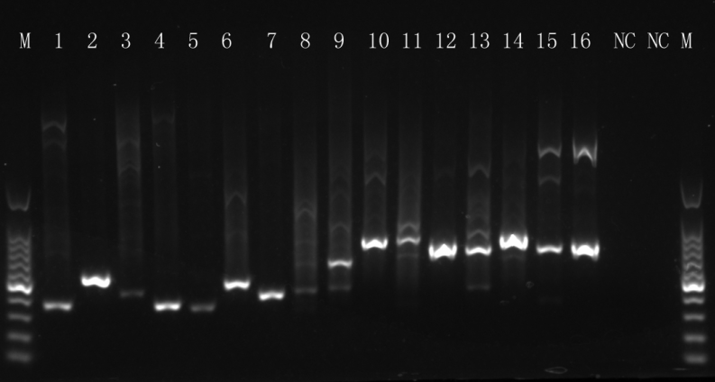
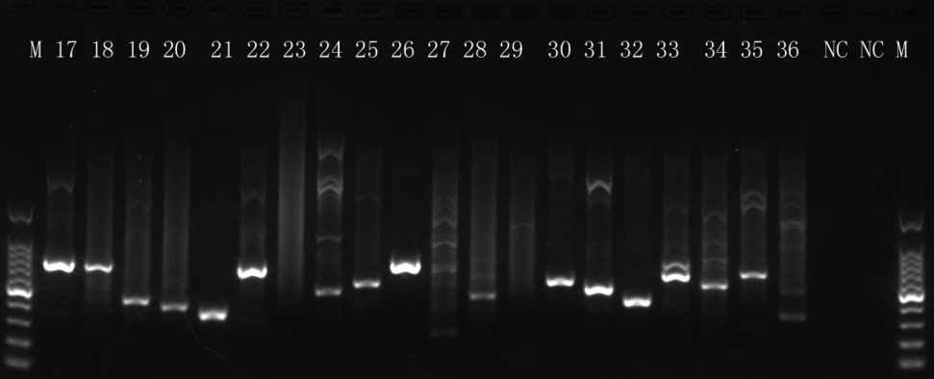
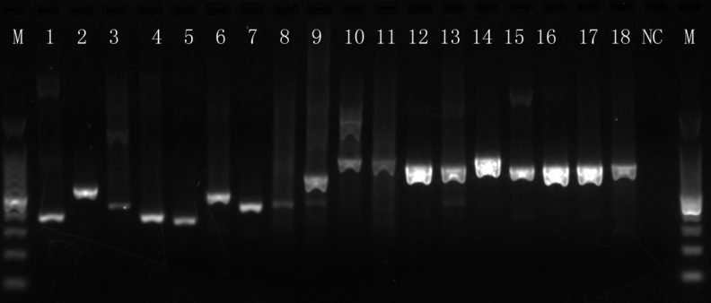
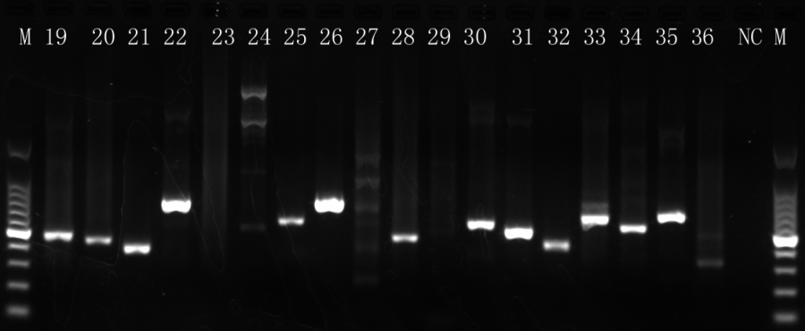
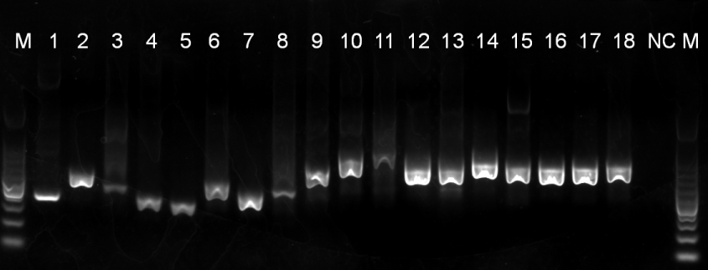
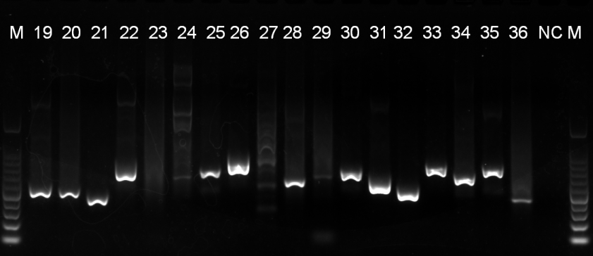
BRCA1 and BRCA2 and Mutations
BRCA2 PCR RESULT
Annealing：55°C
Annealing：58°C
Annealing：60°C

Slide 4
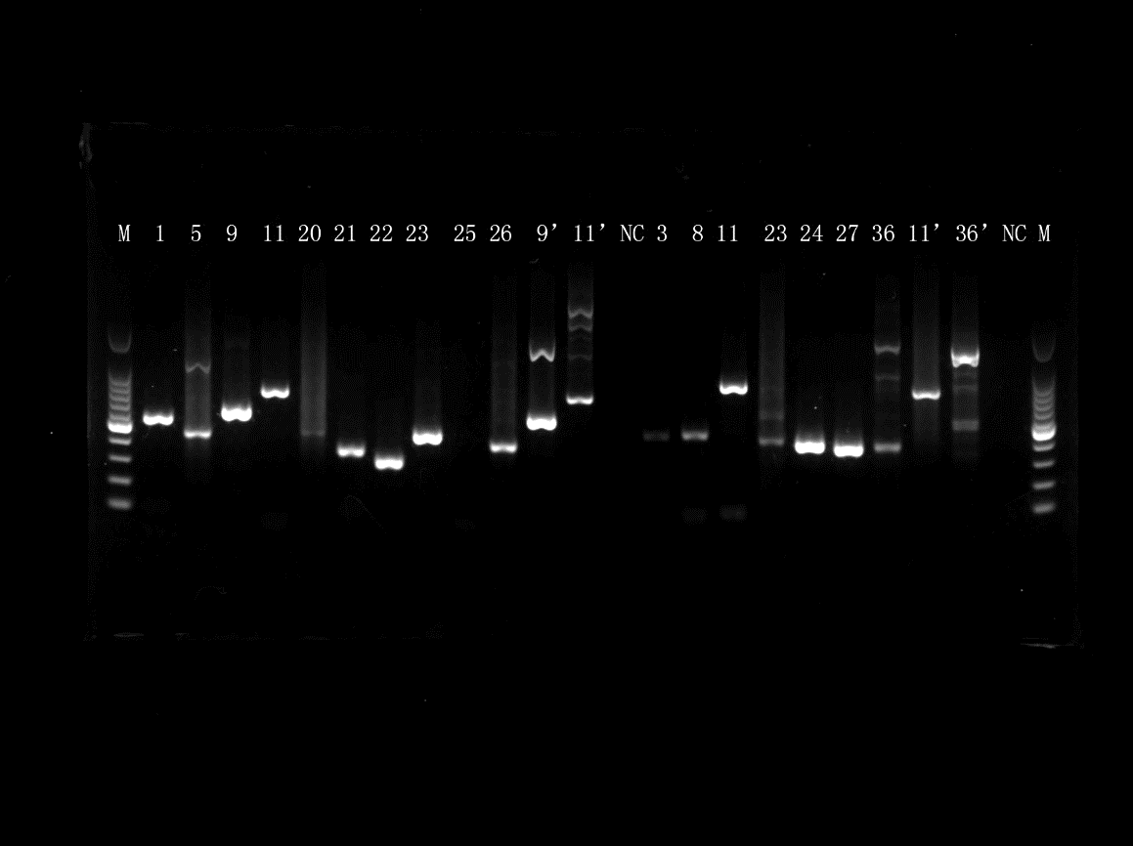
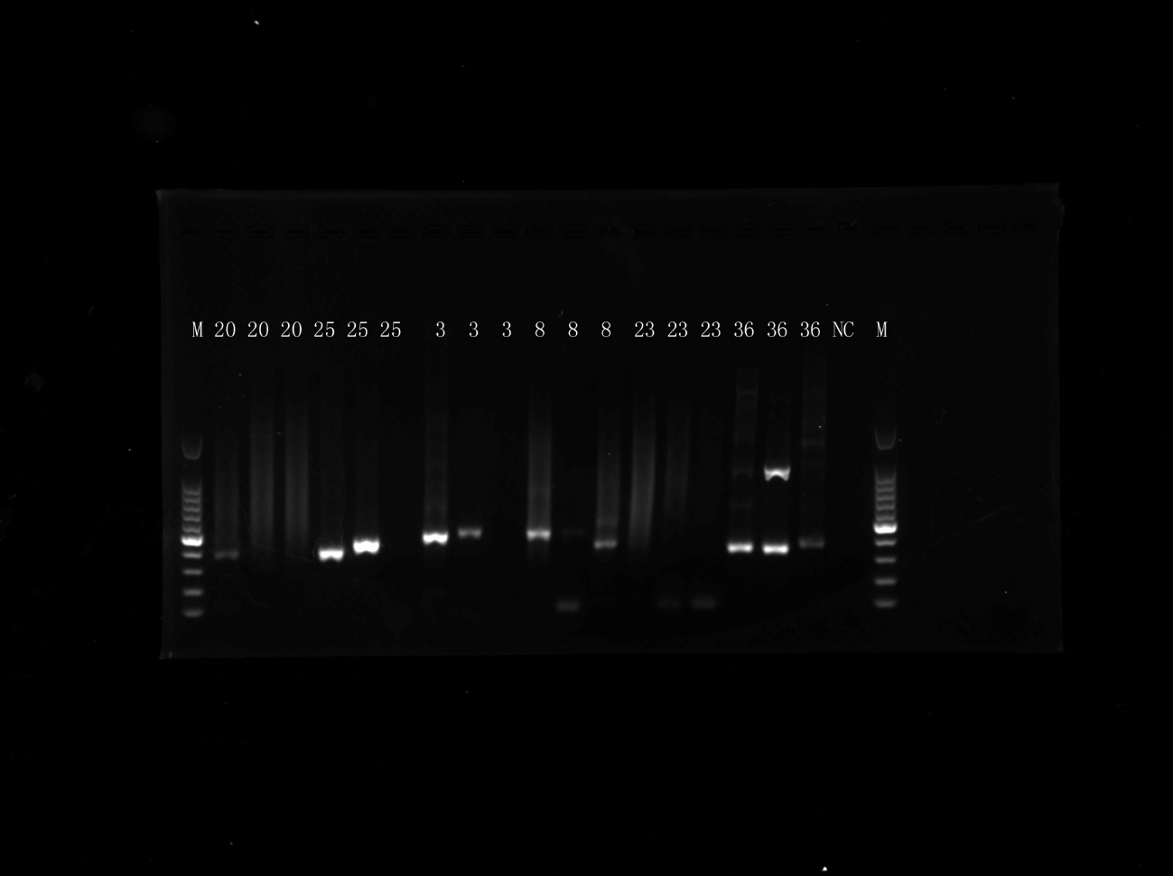
BRCA1 and BRCA2 and Mutations
BRCA PCR RESULT
Annealing：60°C
BRCA1
BRCA2
Annealing：60°C
BRCA1
BRCA2

Slide 5
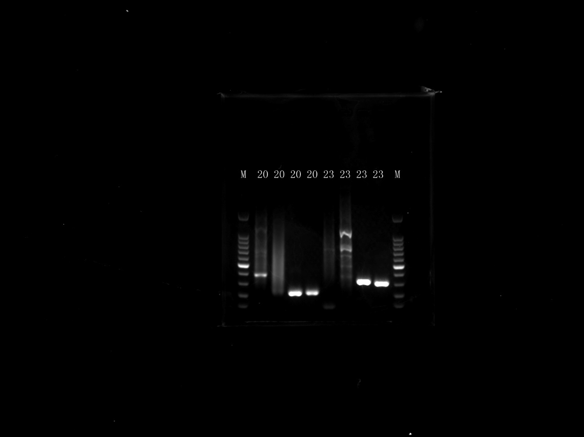
BRCA1 and BRCA2 and Mutations
BRCA PCR RESULT
Annealing：60°C
BRCA1
BRCA2

Slide 6
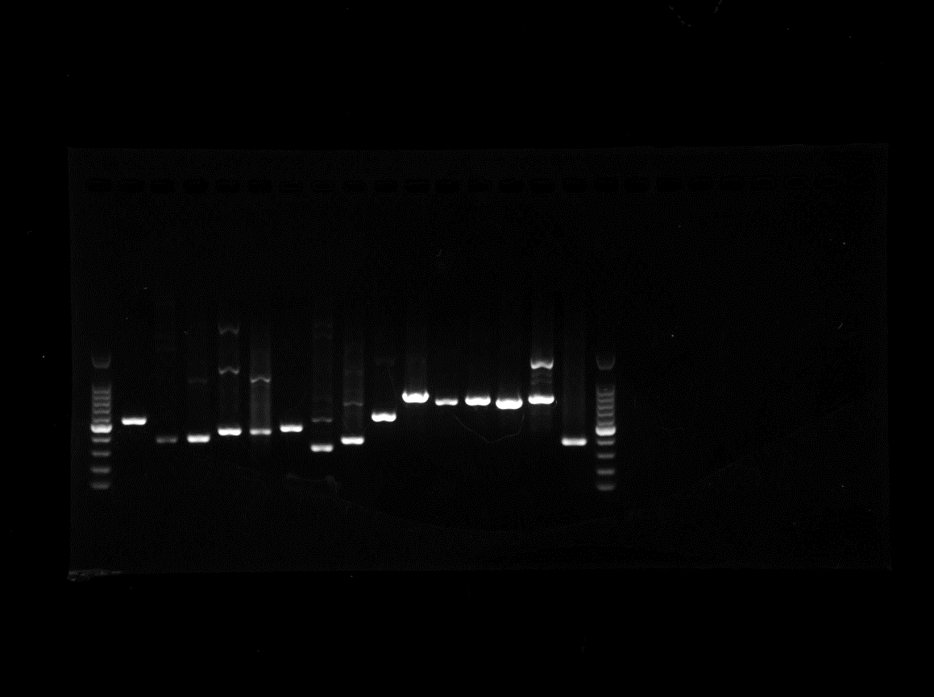
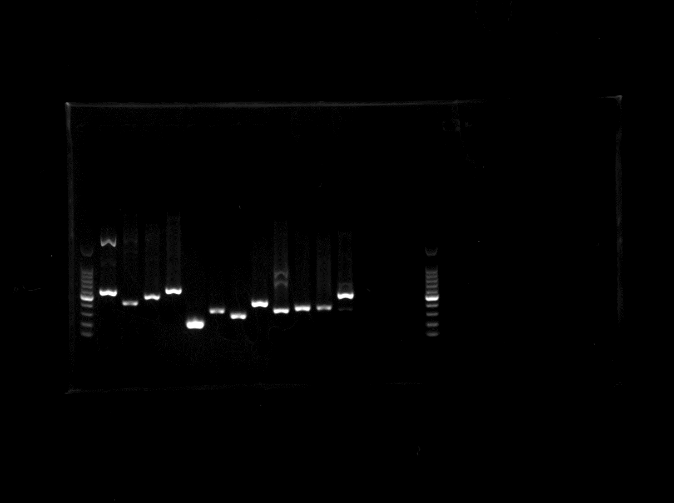
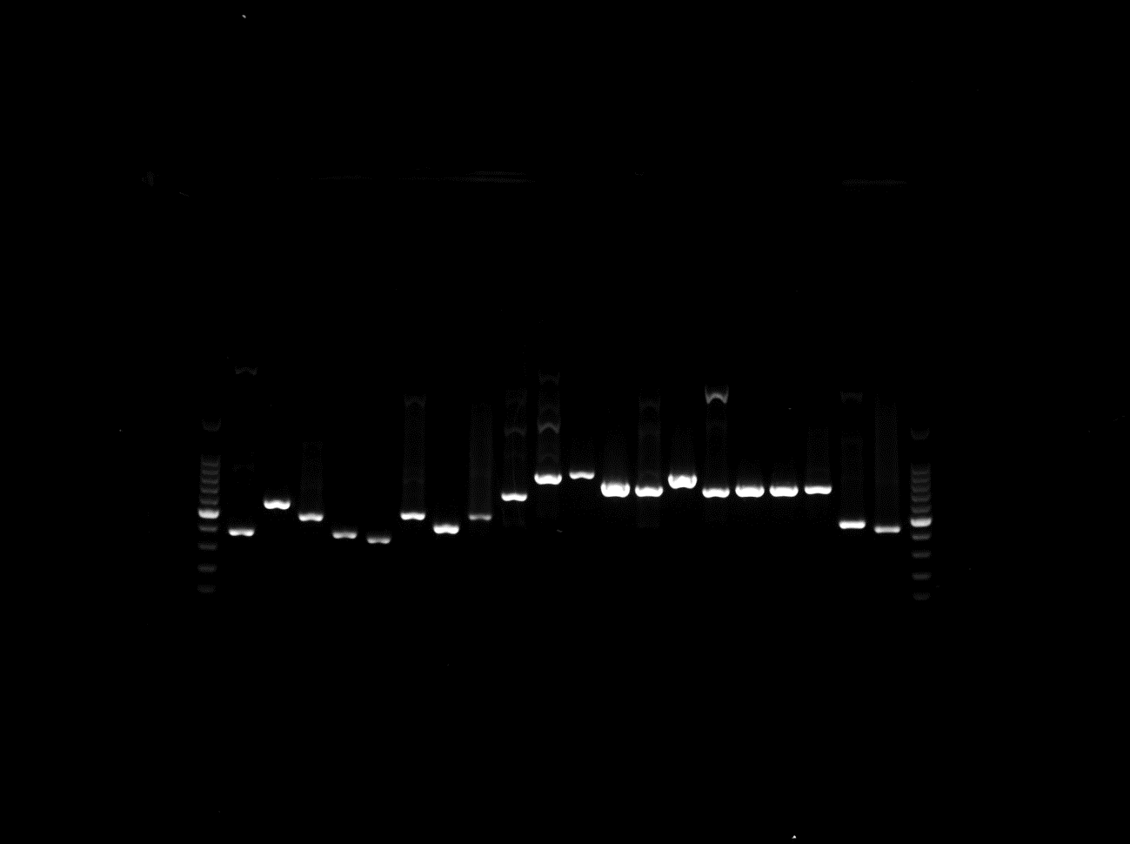
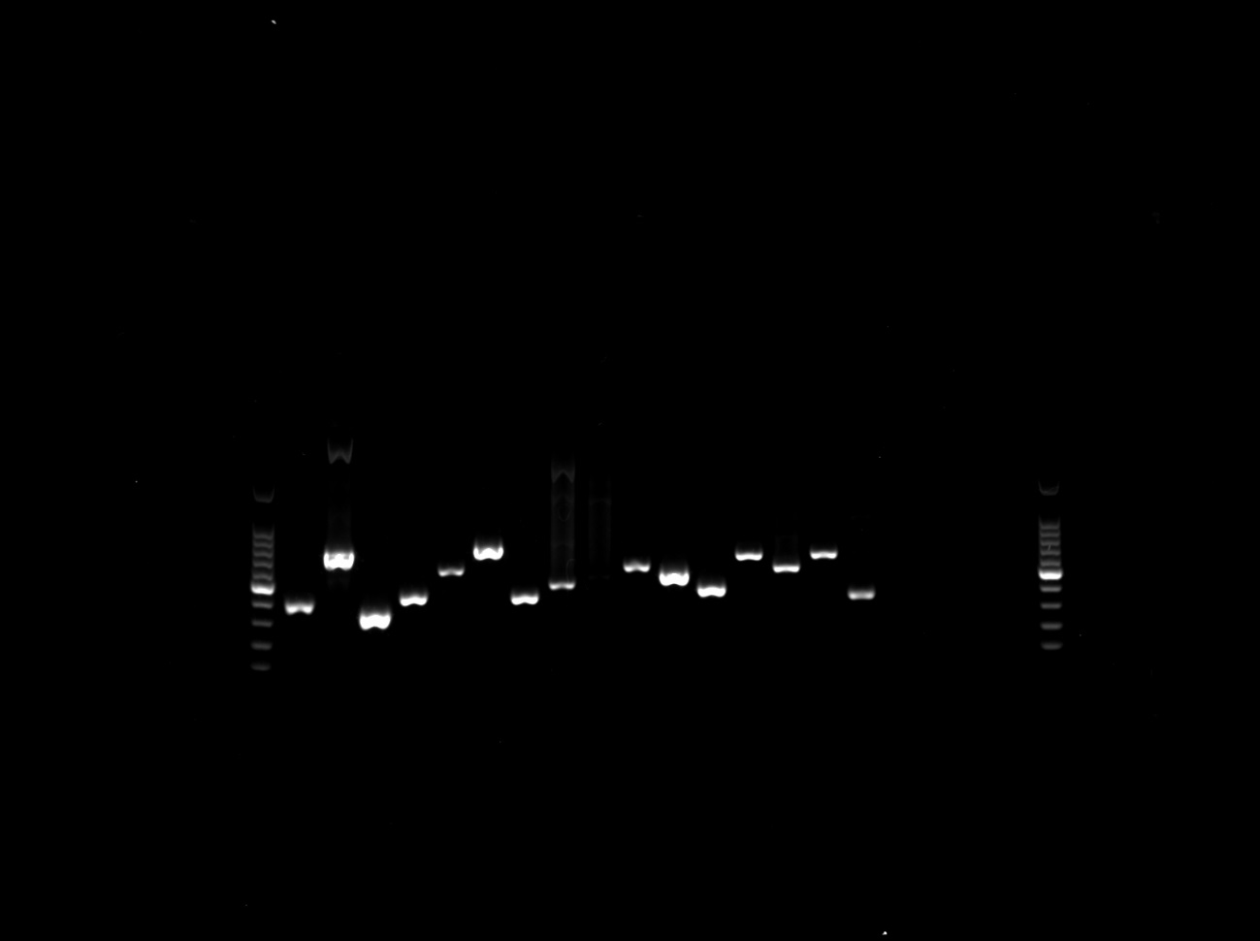
BRCA1 and BRCA2 and Mutations
BRCA1/2 PCR RESULT
M 1 2 3 4 5 6 7 8 9 10 11 12 13 14 15 M
BRCA1
M 16 17 18 19 20 21 22 23 24 25 26 27 NC M
BRCA1
M 1 2 3 4 5 6 7 8 9 10 11 12 13 14 15 16 17 18 19 20 M
BRCA2
M 21 22 23 24 25 26 27 28 29 30 31 32 33 34 35 36 NC M
BRCA2

Slide 7
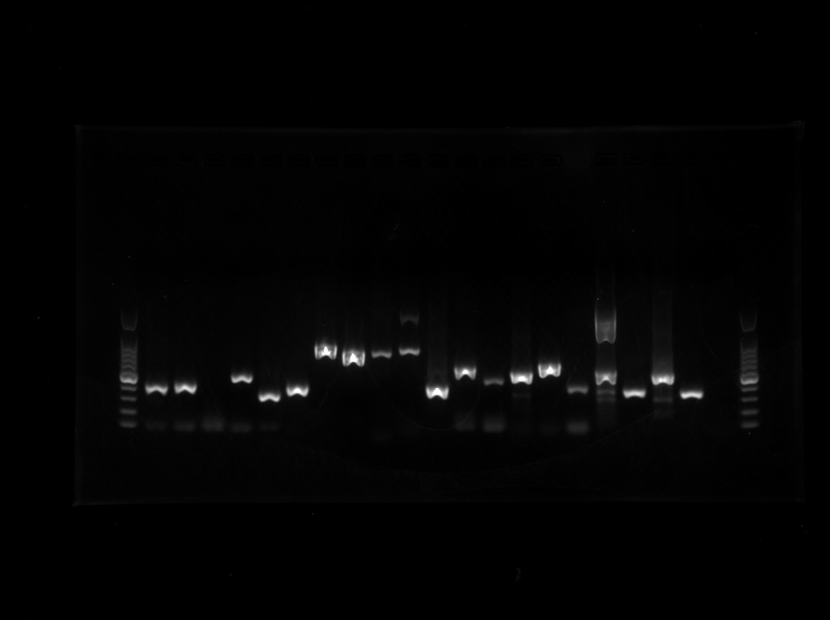
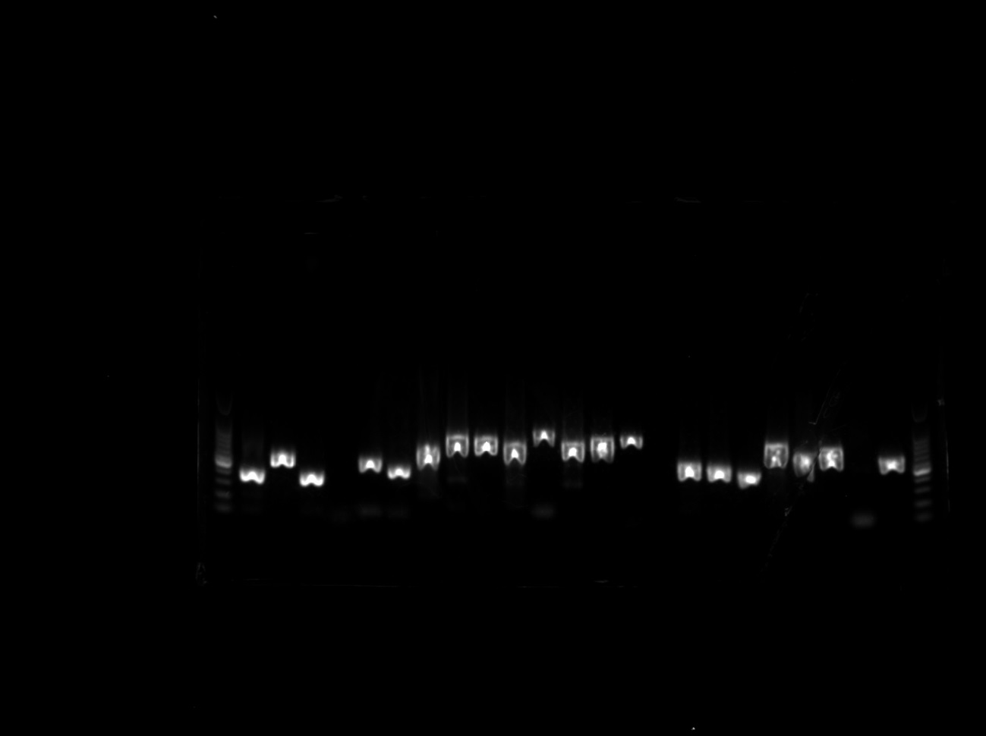
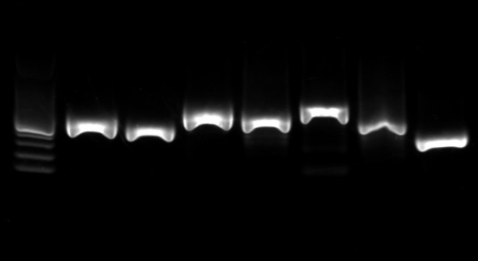
BRCA1 and BRCA2 and Mutations
BRCA PCR RESULT
Annealing：60°C
M 2 3 4 6 7 8 10 12 13 14 15 16 17 18 19 24 25 2’ 25-1 -2 NC M
BRCA1
M 1 2 4 5 6 7 9 10 12 13 14 15 16 17 18 19 20 21 22 25 26 28 30 M
M 1 2 4 5 6 7 9 10 12 13 14 15 16 17 18 19 20 21 22 25 26 28 30 M
BRCA2
M 31 32 33 34 35 29-1 -2

Slide 8
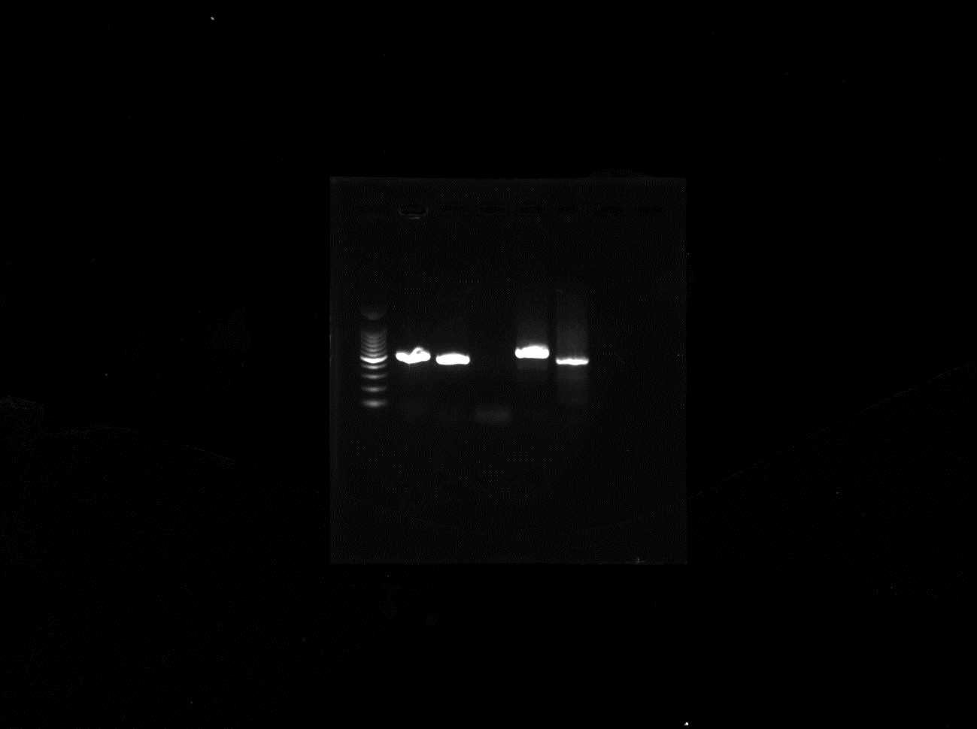
BRCA1 and BRCA2 and Mutations
BRCA PCR RESULT
Annealing：60°C
BRCA1
BRCA2
M 4-1 4-2 5 29-1 29-2

Slide 9
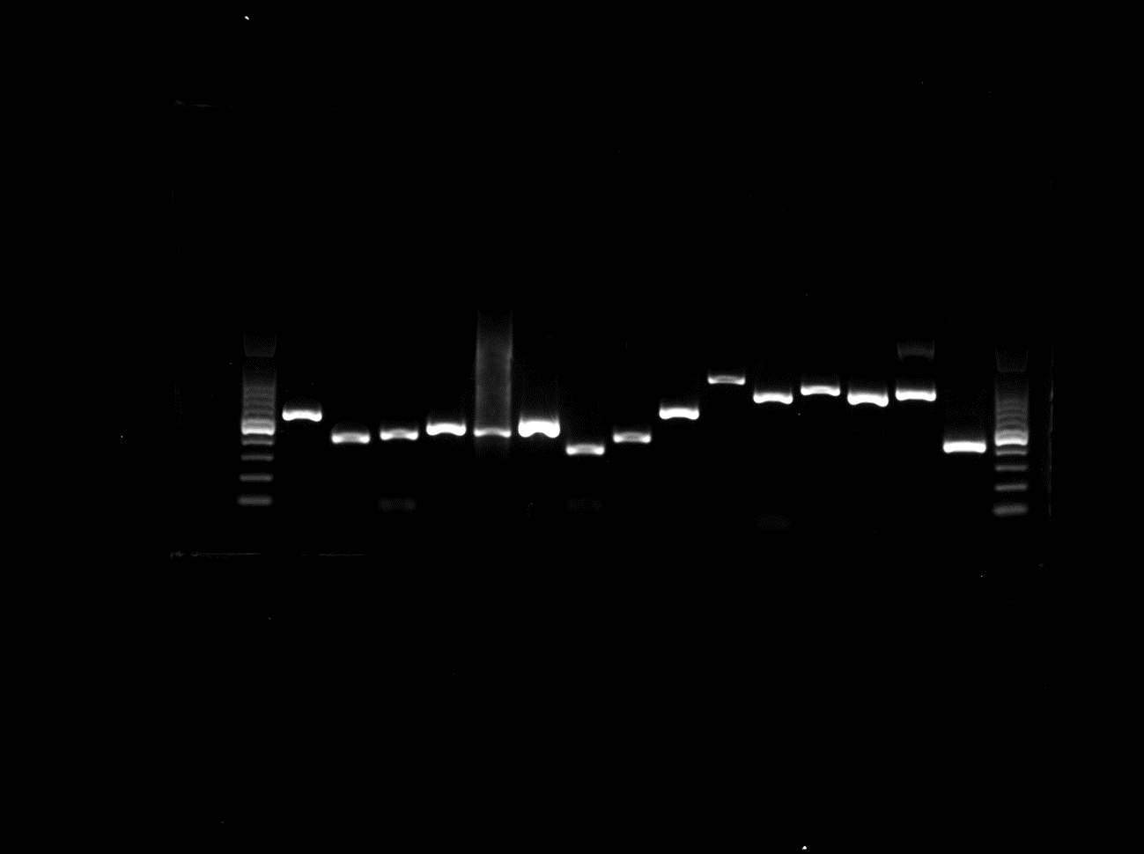
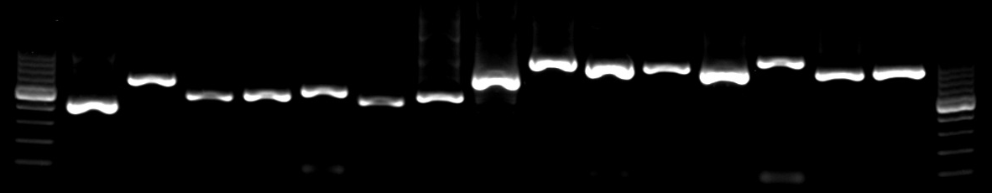
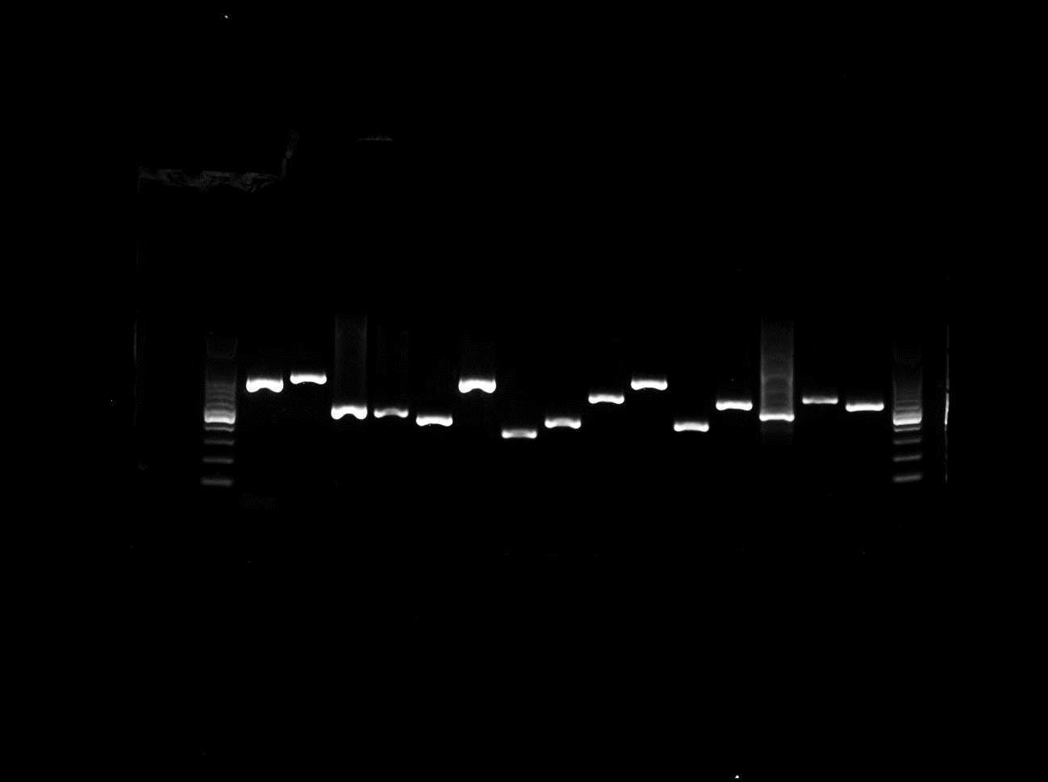
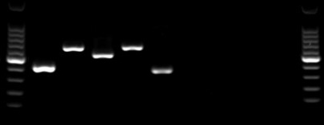
BRCA1 and BRCA2 and Mutations
M 1 2 3 4 5 6 7 8 9 10 11 12 13 14 15 M
BRCA1
M 16 17 18 19 20 21 22 23 24 25 26 27 N C M
BRCA1
M 1 2 3 4 5 6 7 8 9 10 11 12 13 14 15 M
BRCA2
M 16 17 18 19 20 21 22 23 24 25 26 27 28 29 30 M
BRCA2
M 31 32 33 34 35 N C M
BRCA2

Slide 10
Summary and Further plan
The pilot study of PCR of BRCA1 and BRCA2 genes have been done with three annealing temperature, 55°C， 58°C and 60°C，respectively.
The difference between the annealing temperature 58°C and 60°C shows not very obvious. But compared with 55°C, both of the two temperature is better.
Suggest designing the primes again for those exons(labelled with yellow) with not good results.
Remaining six primer pairs(BRCA1, 2 pairs BRCA2, 4 pairs) need to design again.
Remaining 2 primer pairs(each of BRCA1 and BRCA2) need to design again.
All the exons have been successfully amplified. The PCR products were sent to GENEWIZ to sequence by Sanger.

